Slide 1
Internet speed test with flet python
Presenter :- GANESH

Slide 2


Agenda
INTRODUCTION
MODLUES
OUTPUT SLIDES
TEST CASES
GIT-HUD LINKS

Slide 3

Introduction
In this cool app, we've teamed up with Flet for a sleek user interface and relied on MongoDB to keep your data safe and sound. The brains behind the scenes? Python, of course!
you start your journey by signing up, like opening the door to a world of possibilities. Afterward, you simply log in, and there you go. You're in the driver's seat, ready to rev up your internet speeds, checking those uploads and downloads with ease. It's like having your very own digital speedometer for the internet highway!

Slide 4

Libraries used in code
FLET
PYMONGO
SPEEDTEST-CLI
TIME
FLET
Flet is UI (User Interface) Framework for Python that developers can leverage to create UI and build real-time websites, desktop applications, and even mobile applications directly in Python.
Install:- Pip install flet
PYMONGO
PyMongo is used to connect Python applications with MongoDB, a NoSQL database, for data storage and retrieval. It facilitates CRUD operations, complex queries, and data transformations. PyMongo is essential for building scalable and data-intensive applications with MongoDB.

Slide 5
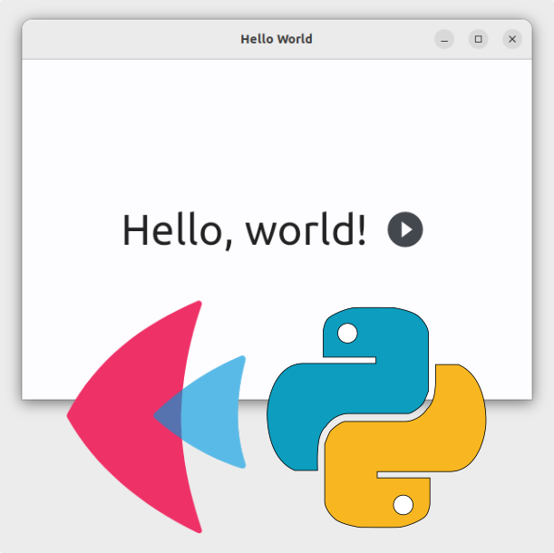
SPEEDTEST-CLI
Speed test-cli is a module that is used in the command-line interface for testing internet bandwidth using speedtest.net
Install:-Pip install speedtest-cli
TIME
Python's time module provides a function for getting local time from the number of seconds elapsed since the epoch called localtime()

Slide 6
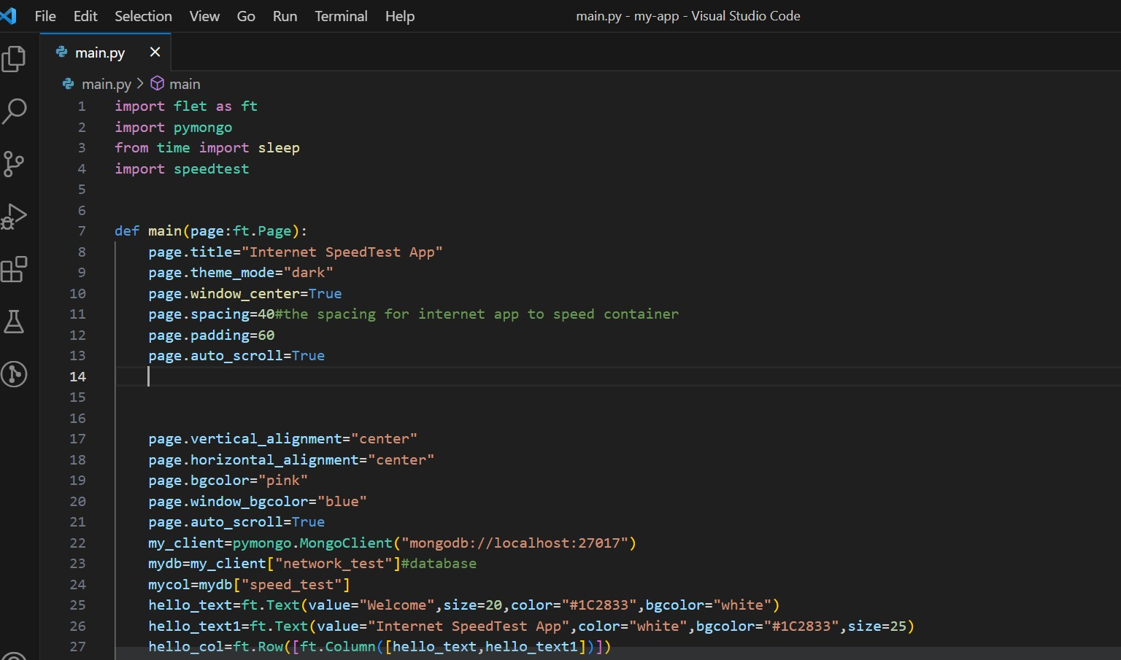
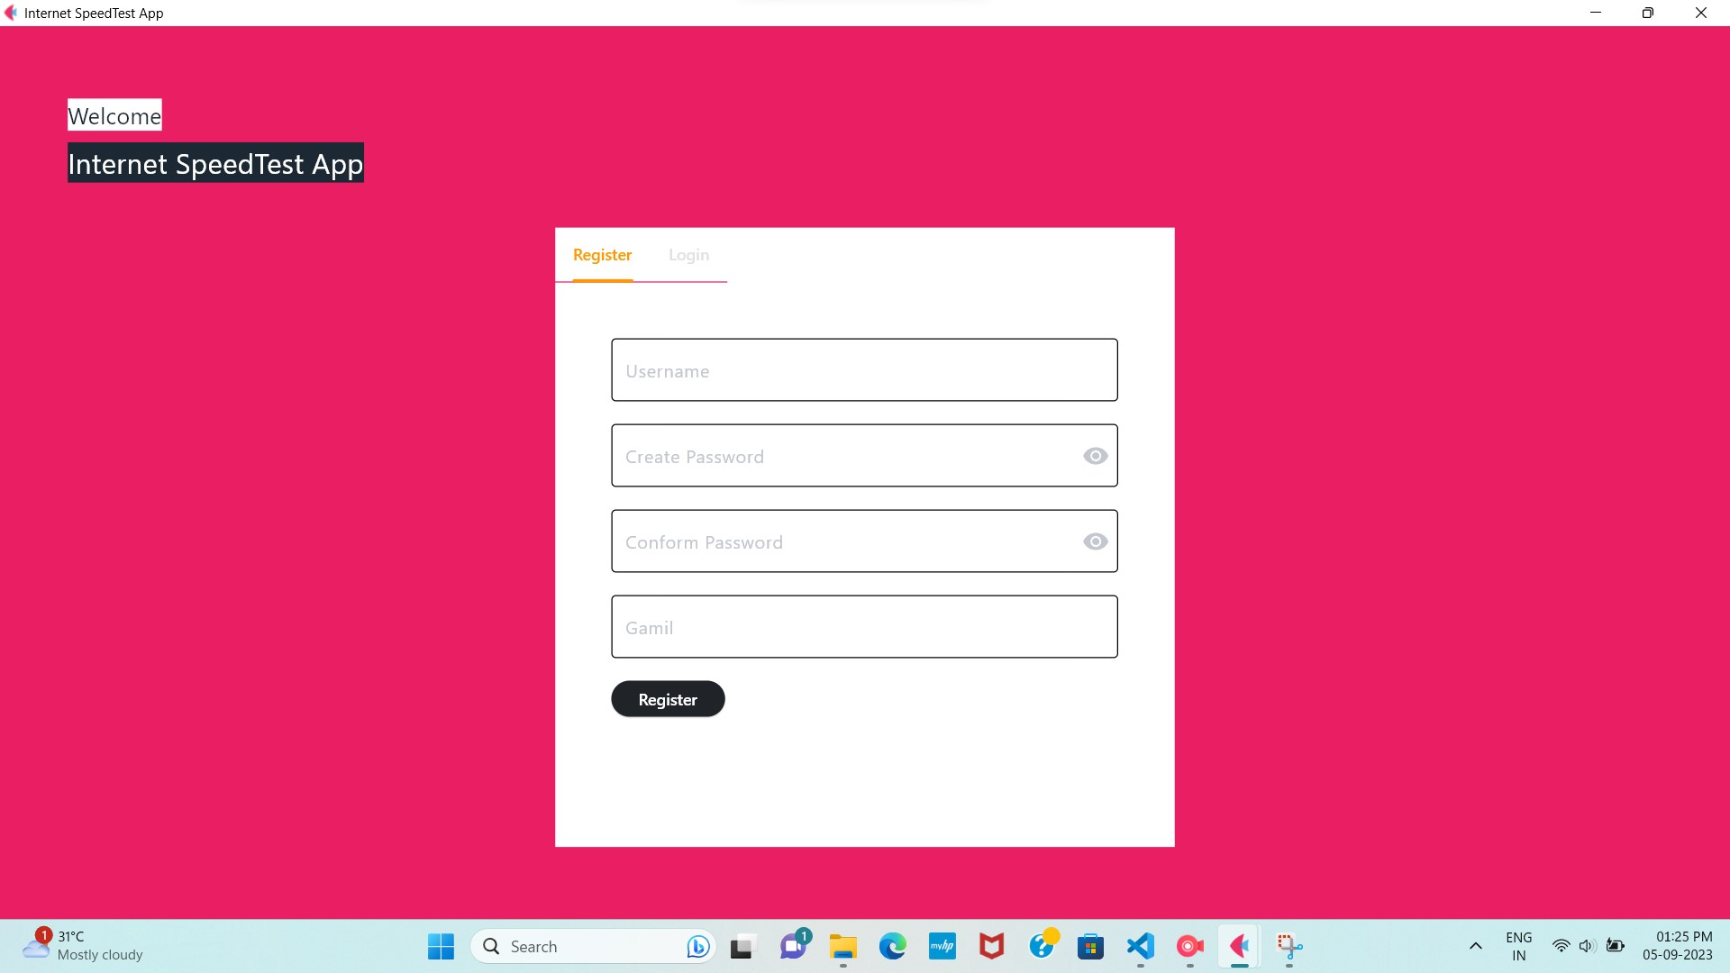
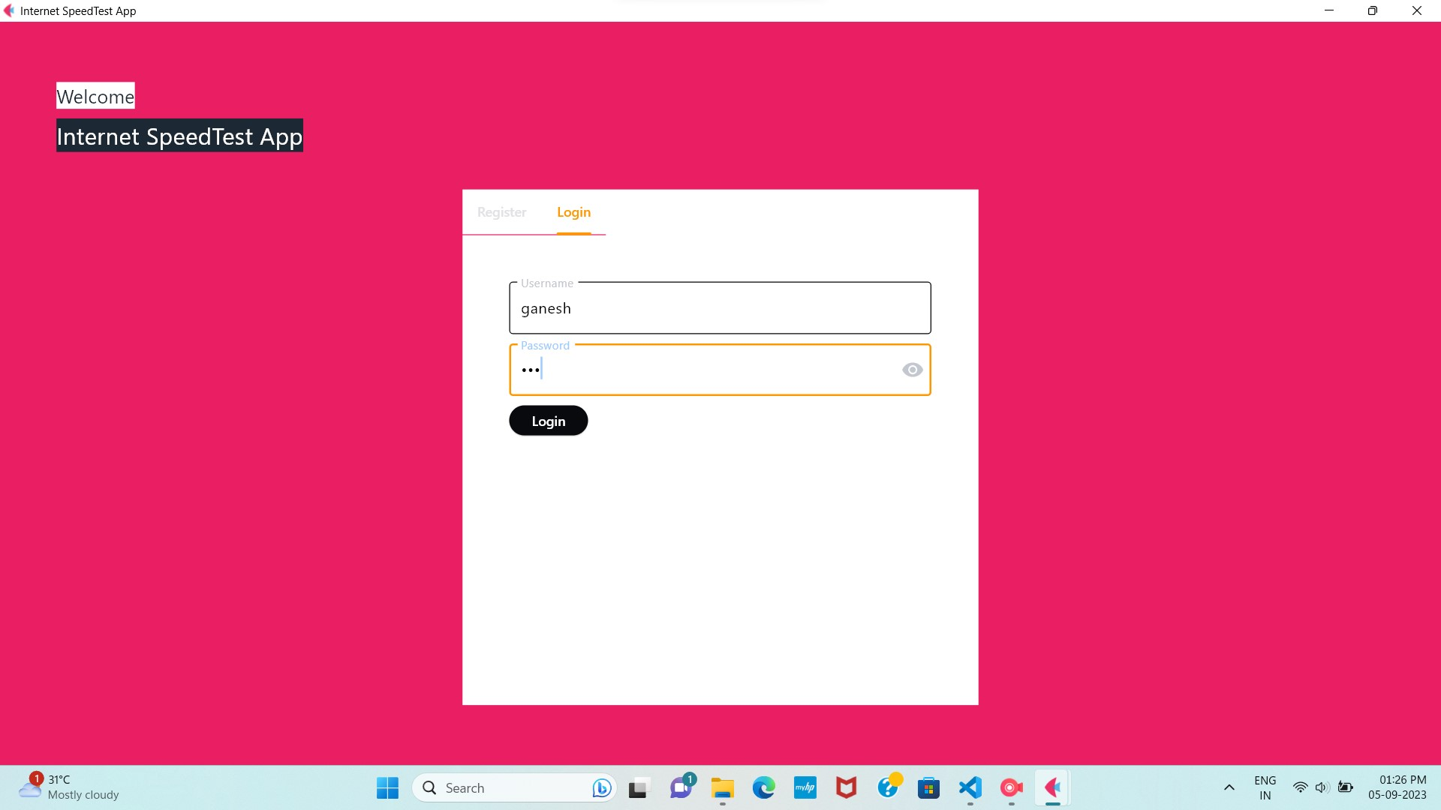
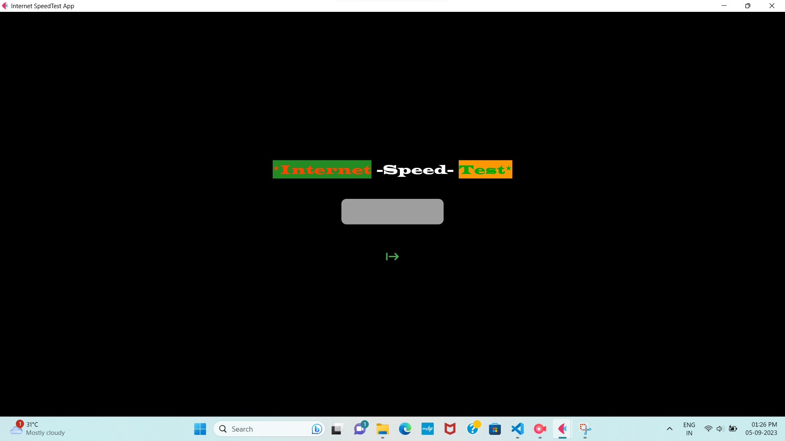
Output slides

Slide 7
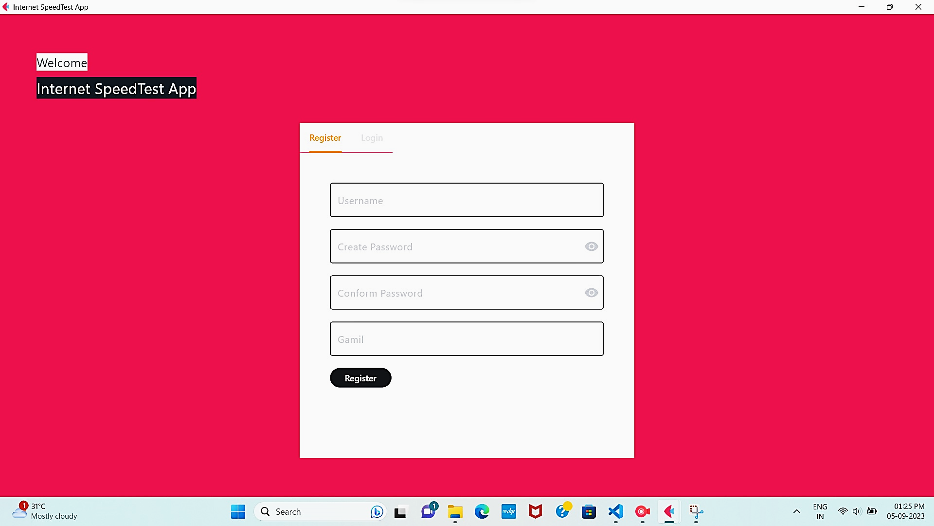
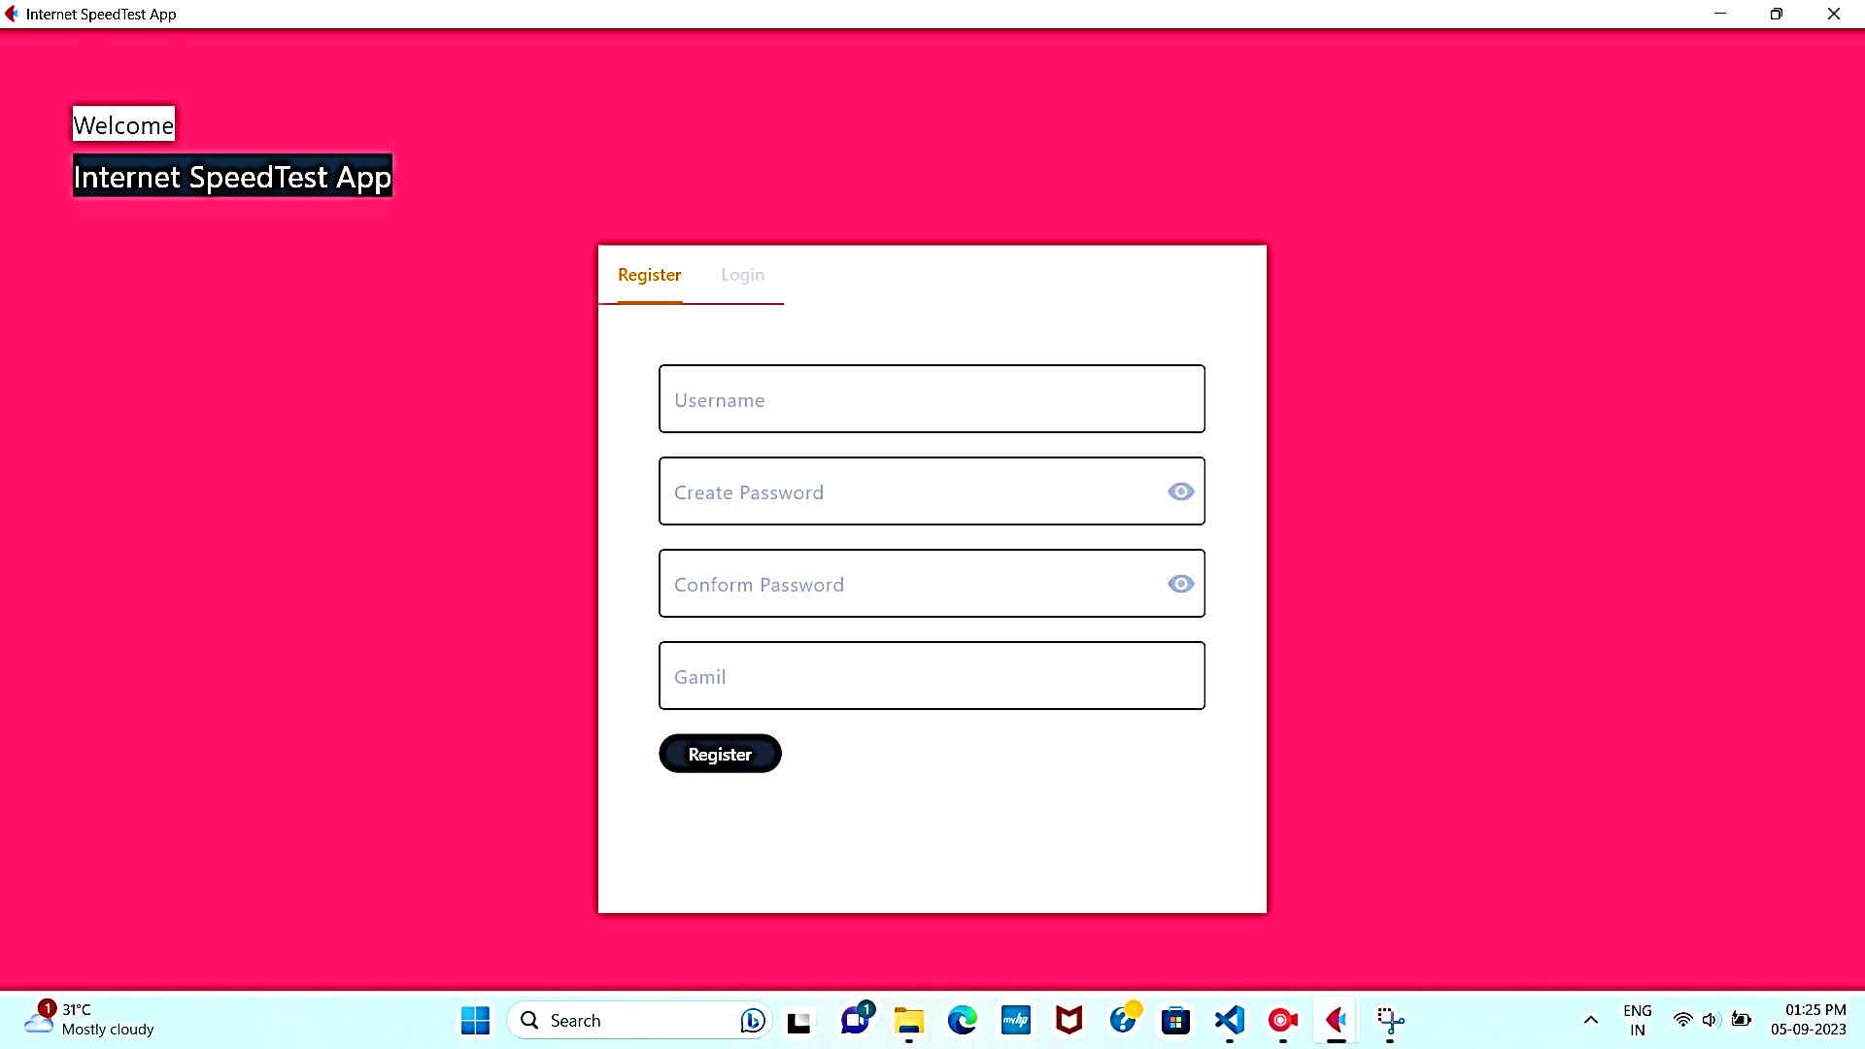
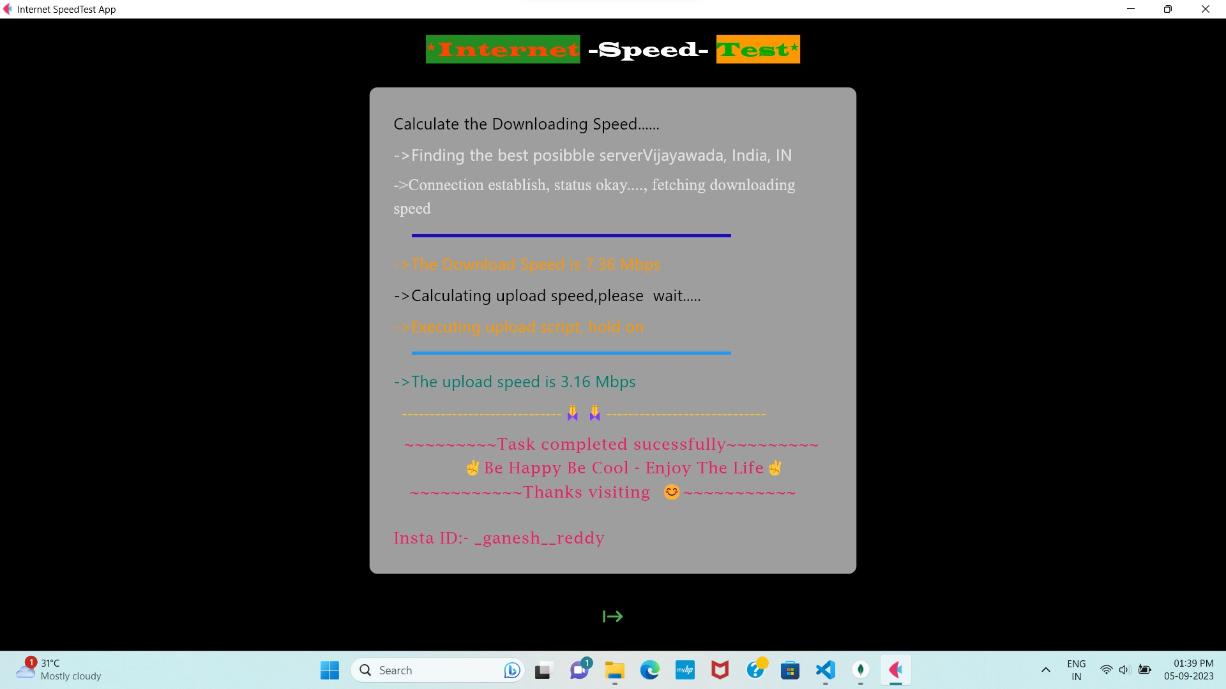

Slide 8
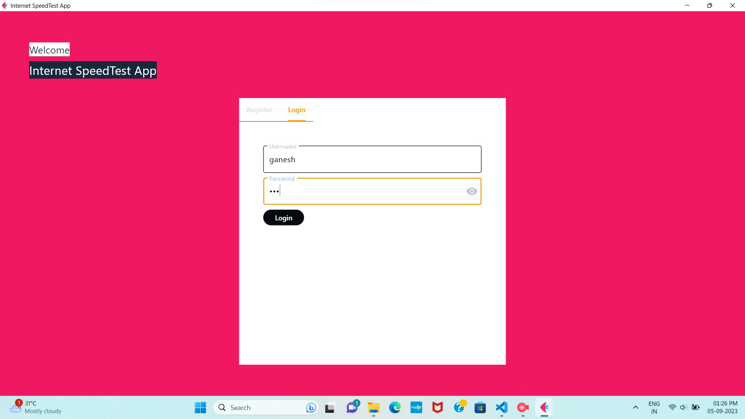

Slide 10
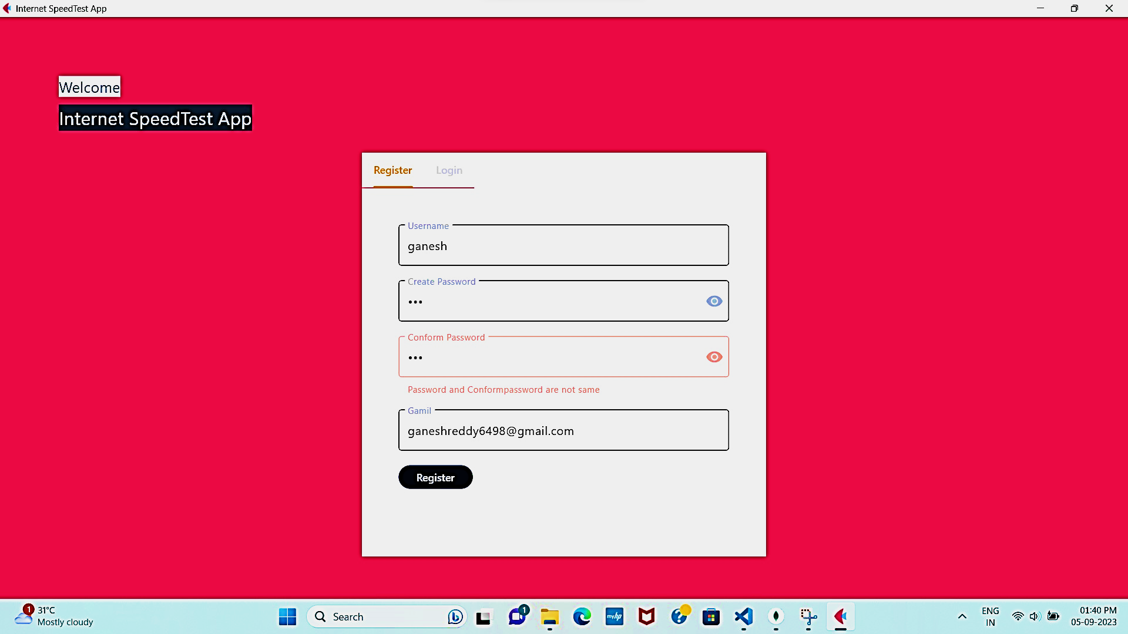
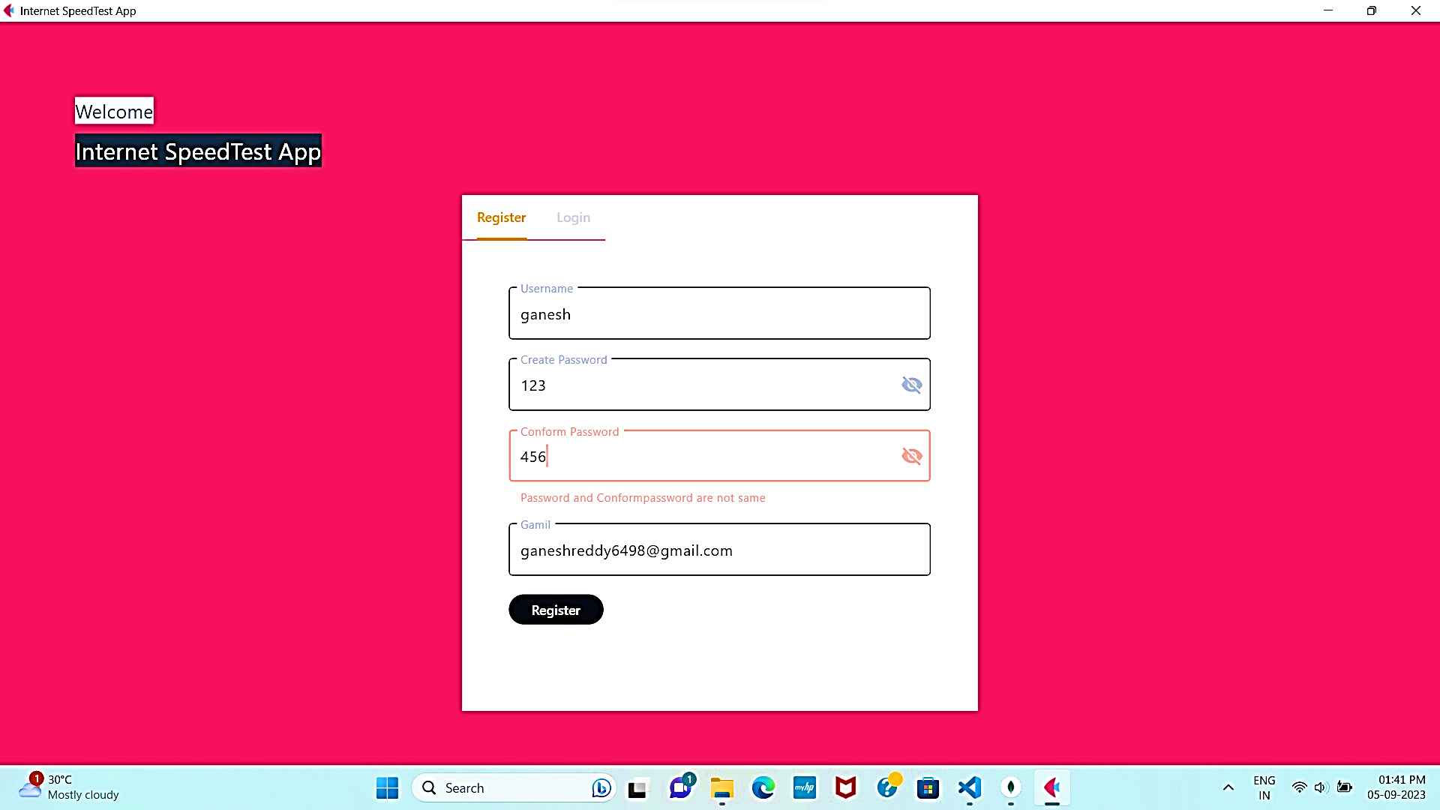
Test Cases
Give the input different in password and conform password

Slide 11
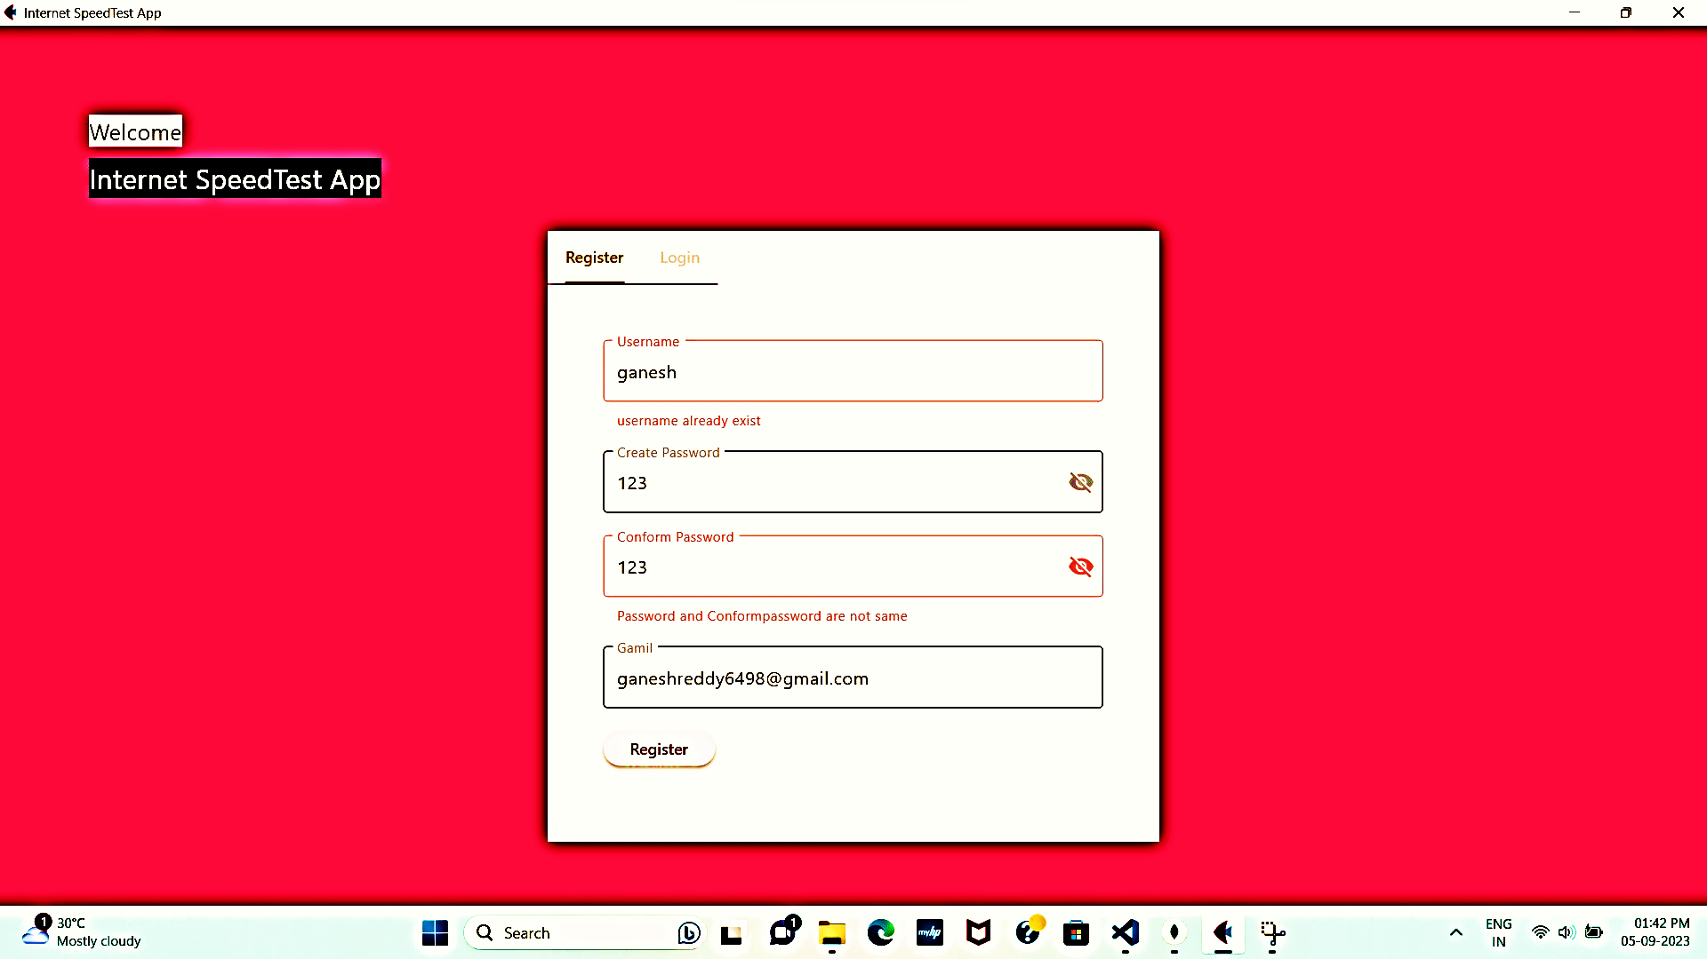
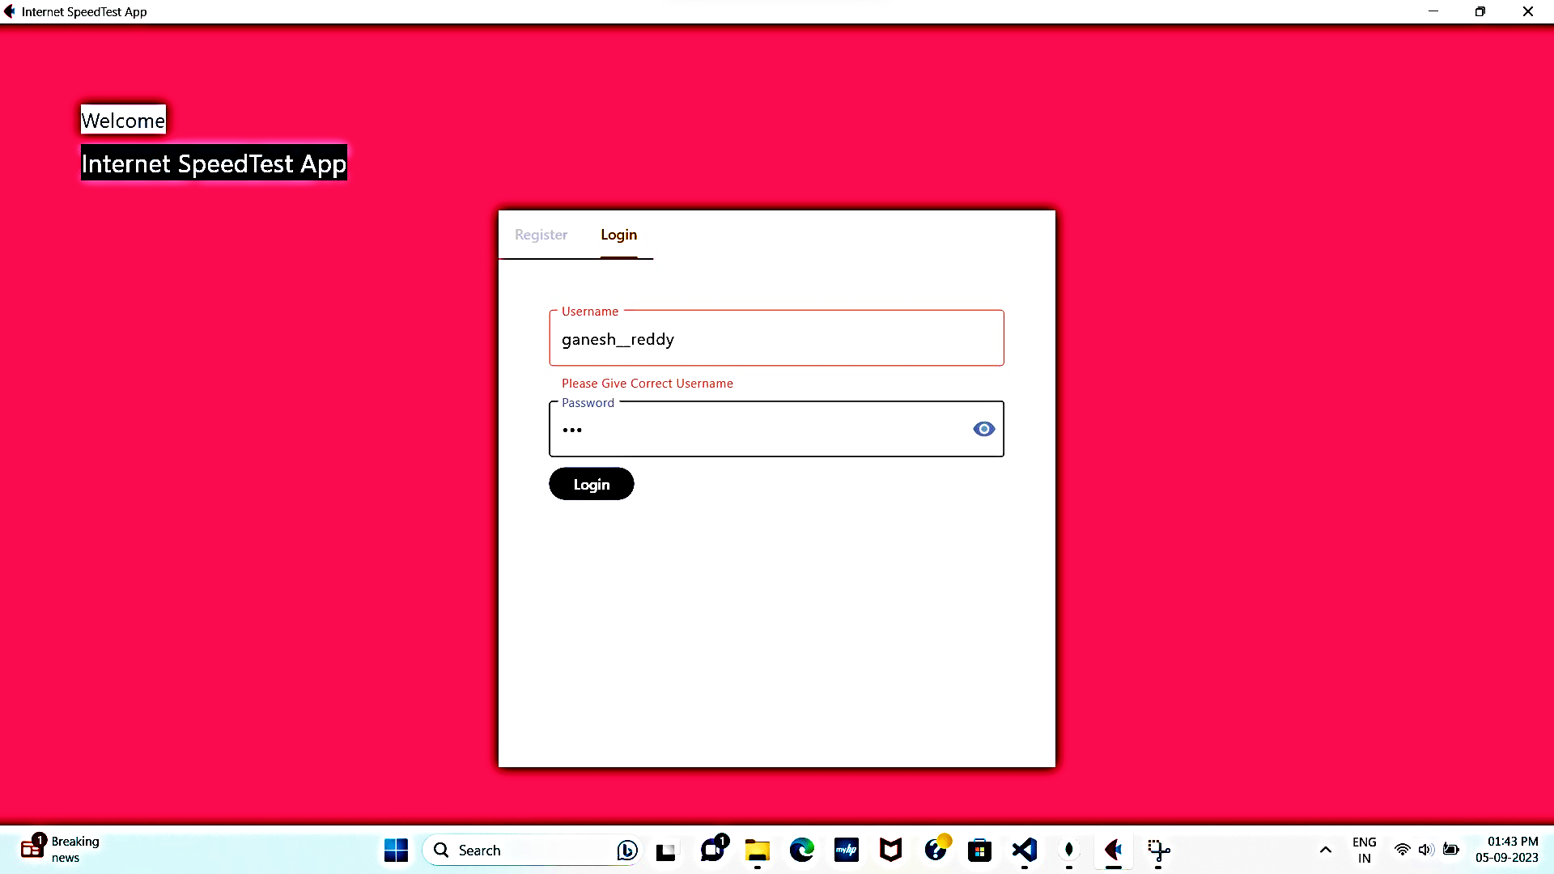
Give username that which already taken by some other user
Given username is incorrect

Slide 12
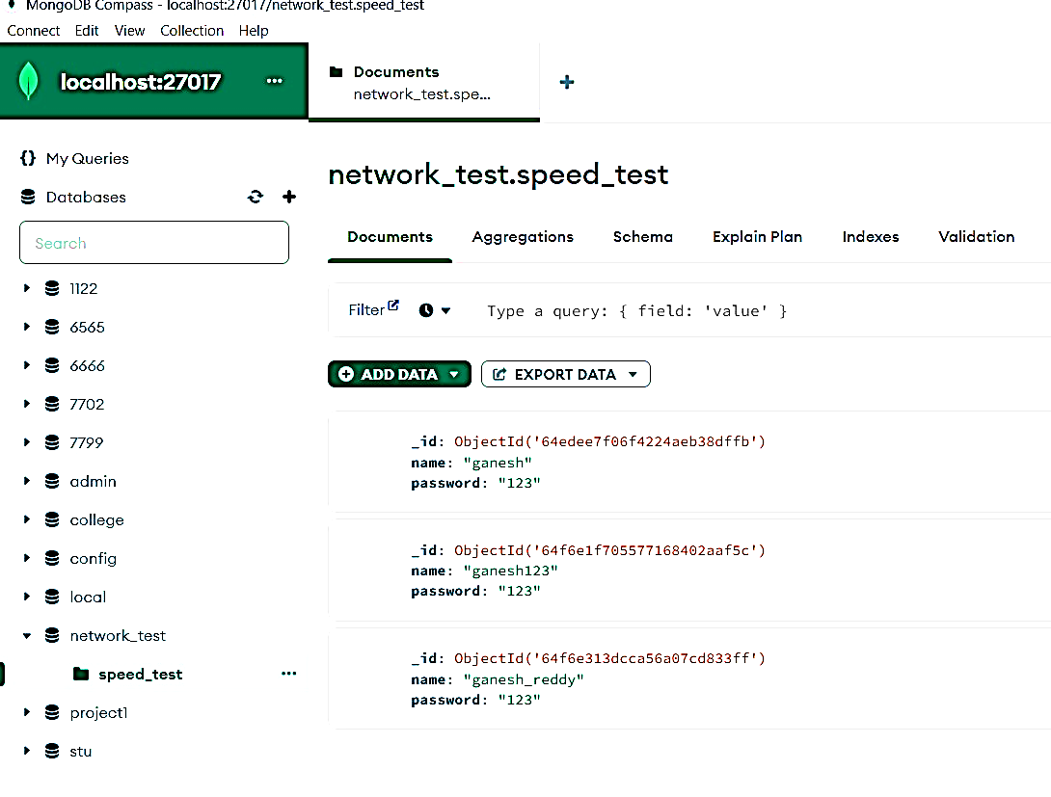
DATA STORED IN DATABASE

Slide 13




Thank you
Presenter:-Ganesh
Email address:-ganeshreddy6498@gmail.com
Website:-
GitHub link for code:- code link
LinkedIn:- linkedin.com/in/ganesh-reddy

